Slide 1
Spring Boot
Shopping Mall
Spring Boot Project
부산 IT 교육센터 빅데이터 시각화를 통한 빅데이터 UI 콘텐츠 개발
전하정

Slide 2
Goal
STEP. 2
ERD
STEP. 1
USE CASE
STEP. 3
개발 화면 시연

Slide 3
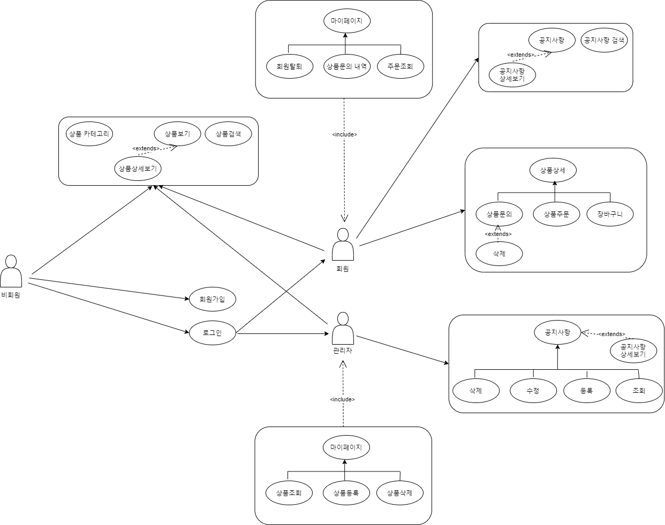
USE CASE

Slide 4
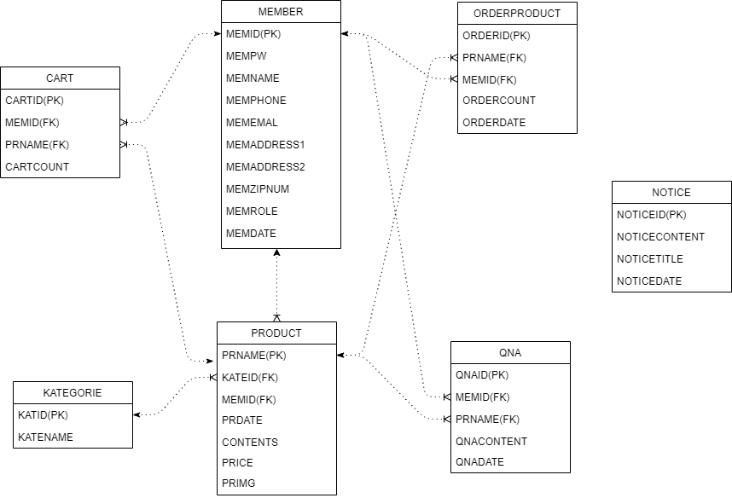
Table 구조도

Slide 5
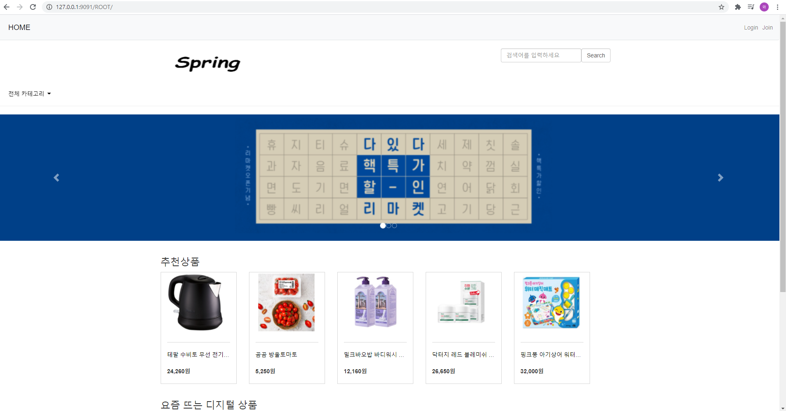
http://127.0.0.1:9090/ROOT/
▲ ▼

Slide 6
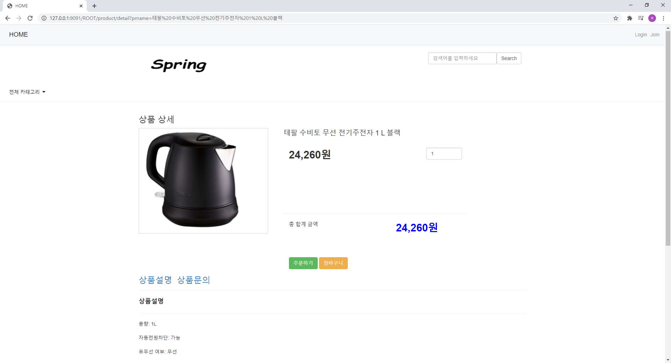
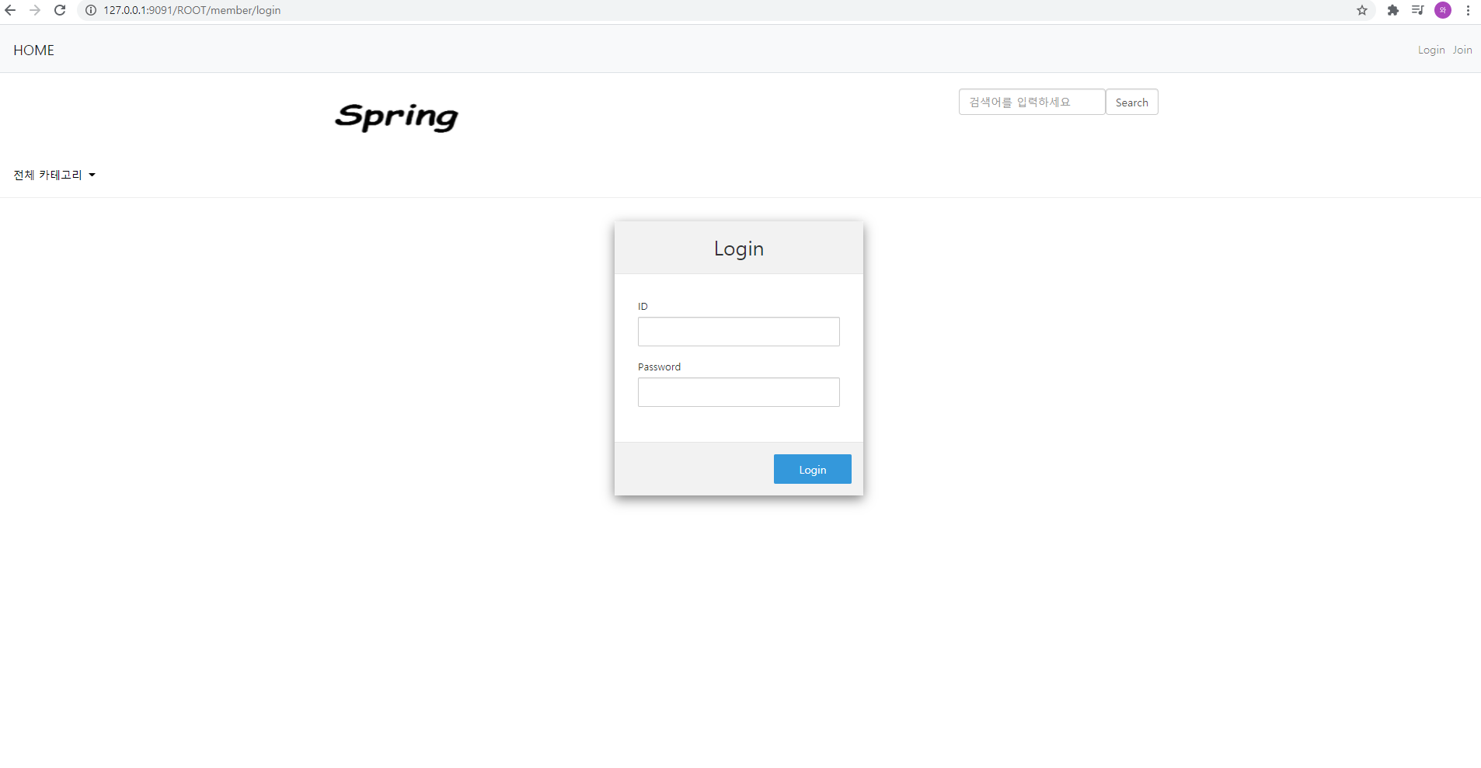
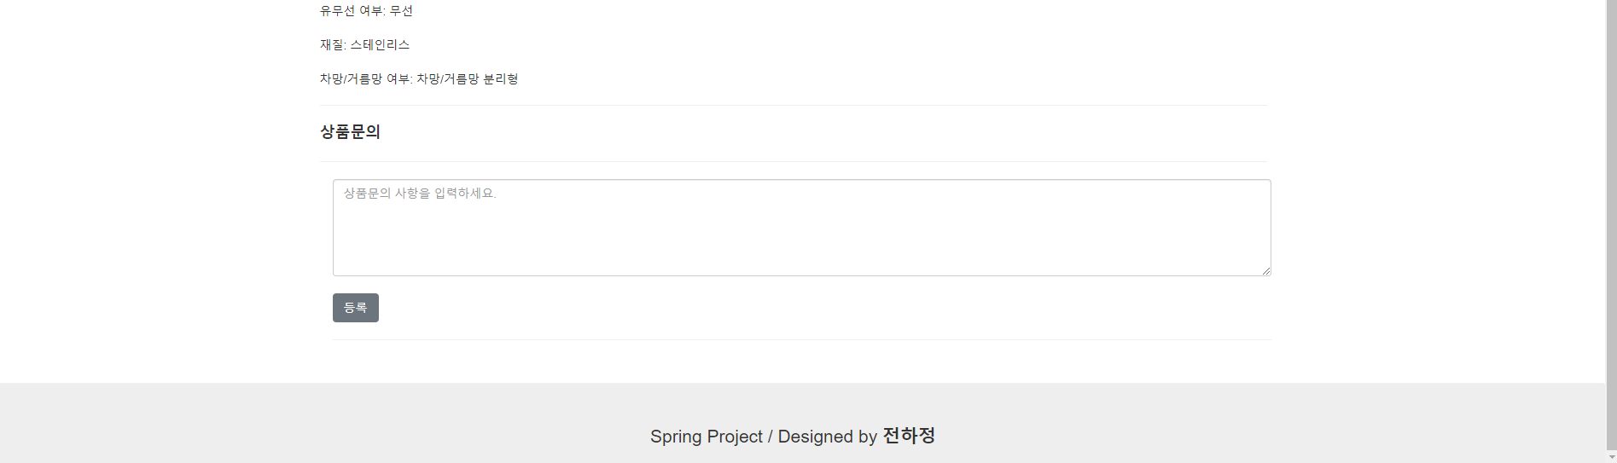
http://127.0.0.1:9091/ROOT/product/detail?prname=...
▲ ▼

Slide 7
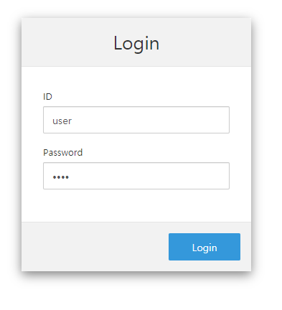
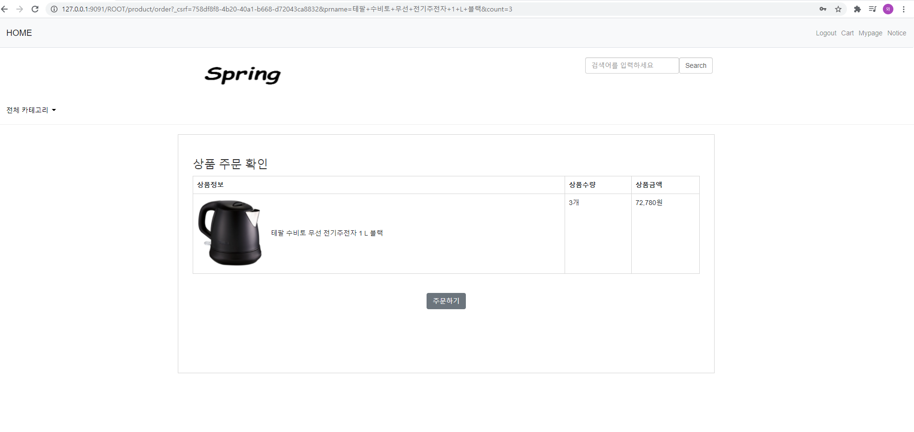
http://127.0.0.1:9090/ROOT/ member/join
▲ ▼

Slide 8
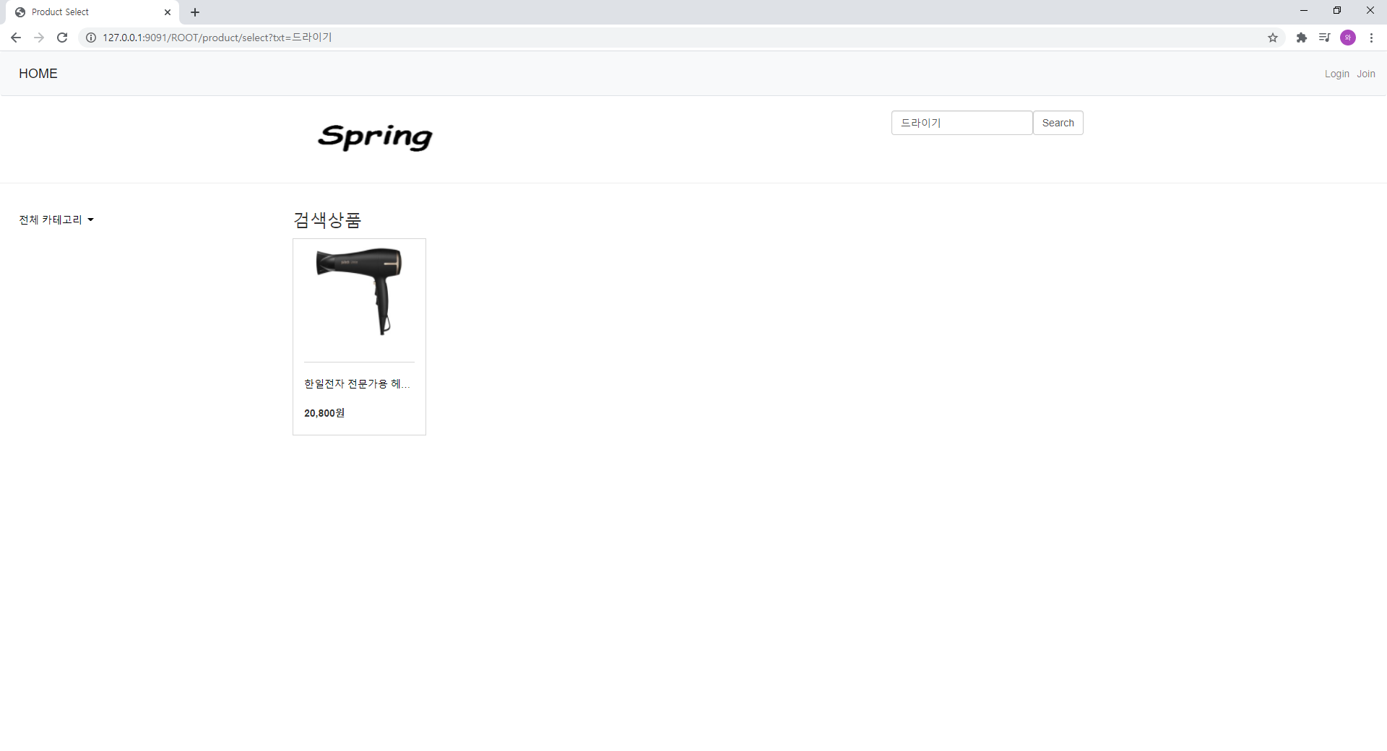
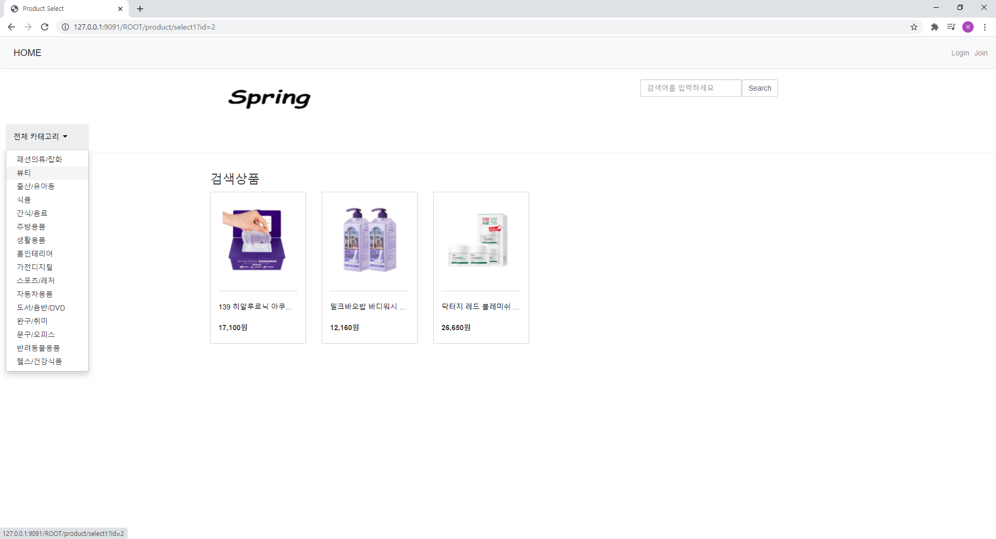
http://127.0.0.1:9091/ROOT/product/select1?id=2
▲ ▼

Slide 9
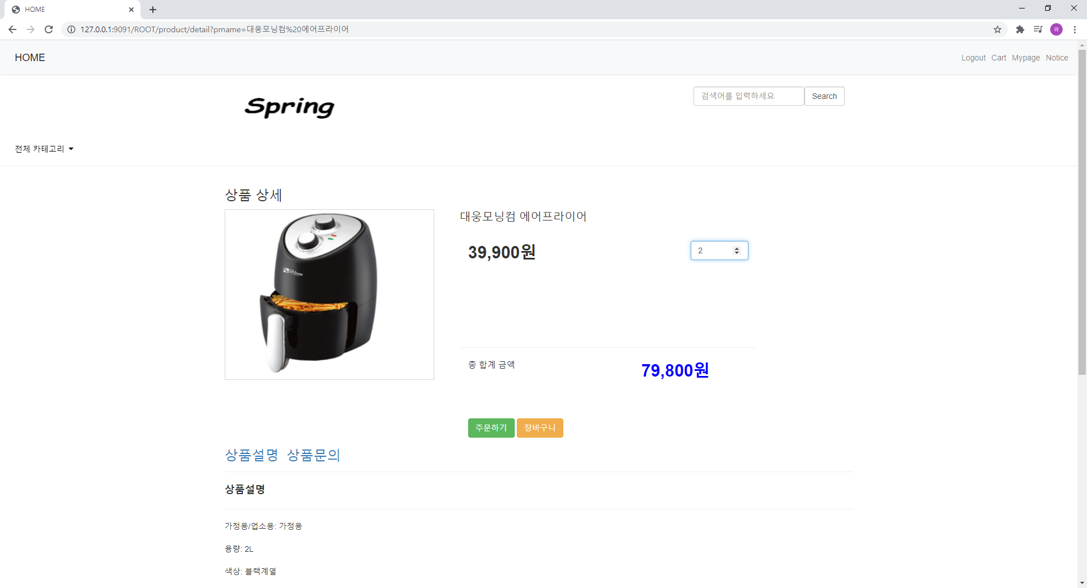
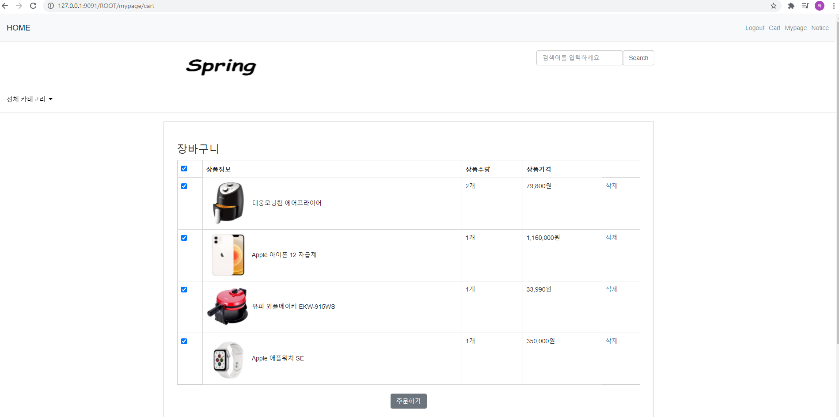
http://127.0.0.1:9090/ROOT/ mypage/cart
▲ ▼

Slide 10
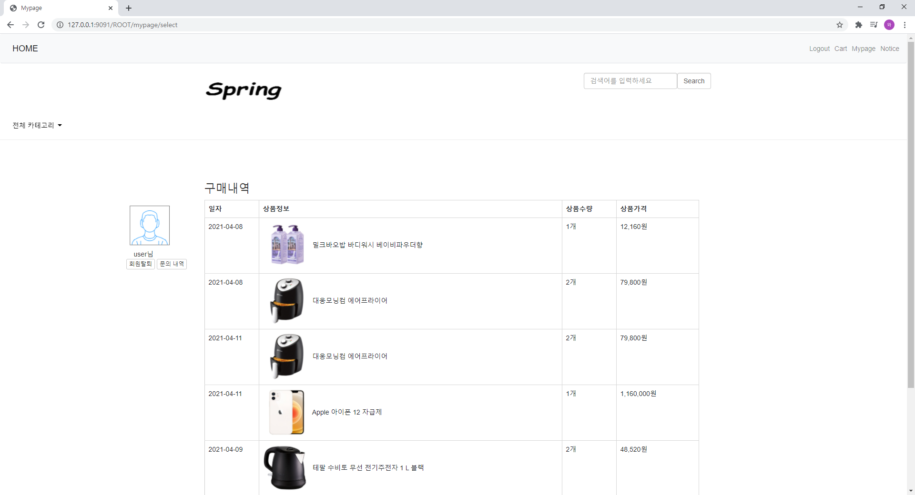
http://127.0.0.1:9090/ROOT/ mypage/cart
▲ ▼

Slide 11
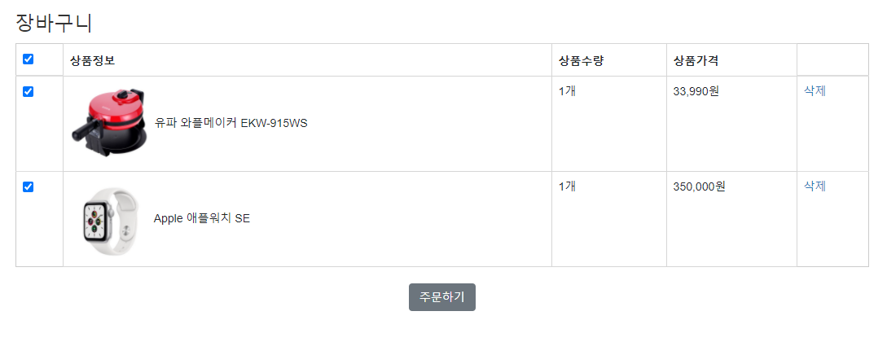
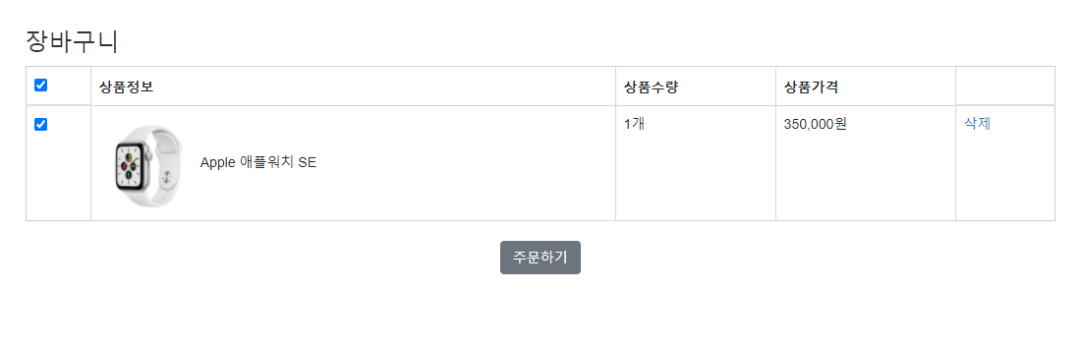
http://127.0.0.1:9091/ROOT/mypage/cart
▲ ▼

Slide 12
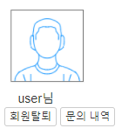
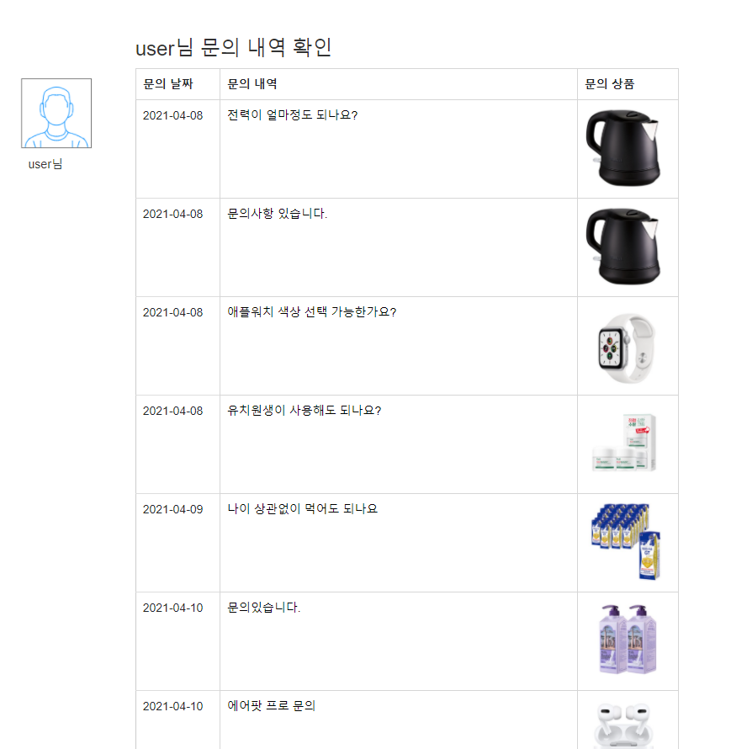
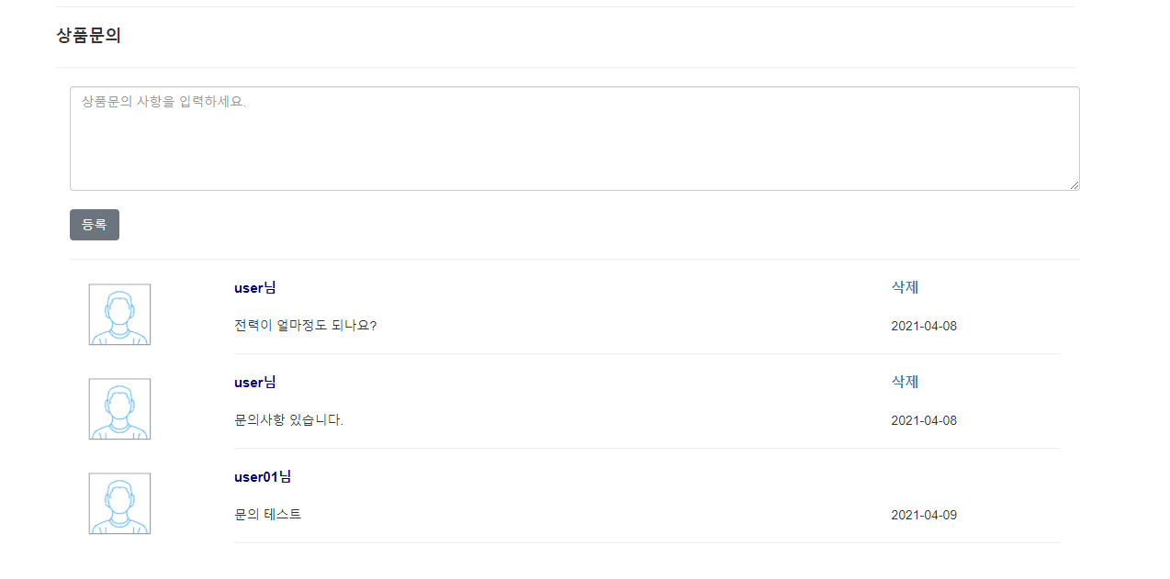
http://127.0.0.1:9091/ROOT/mypage/qna
▲ ▼

Slide 13
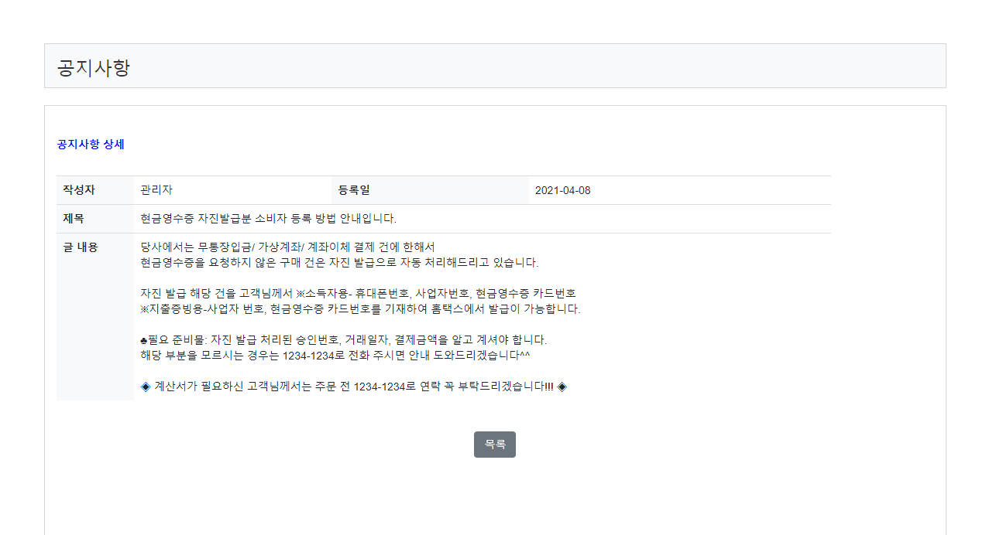
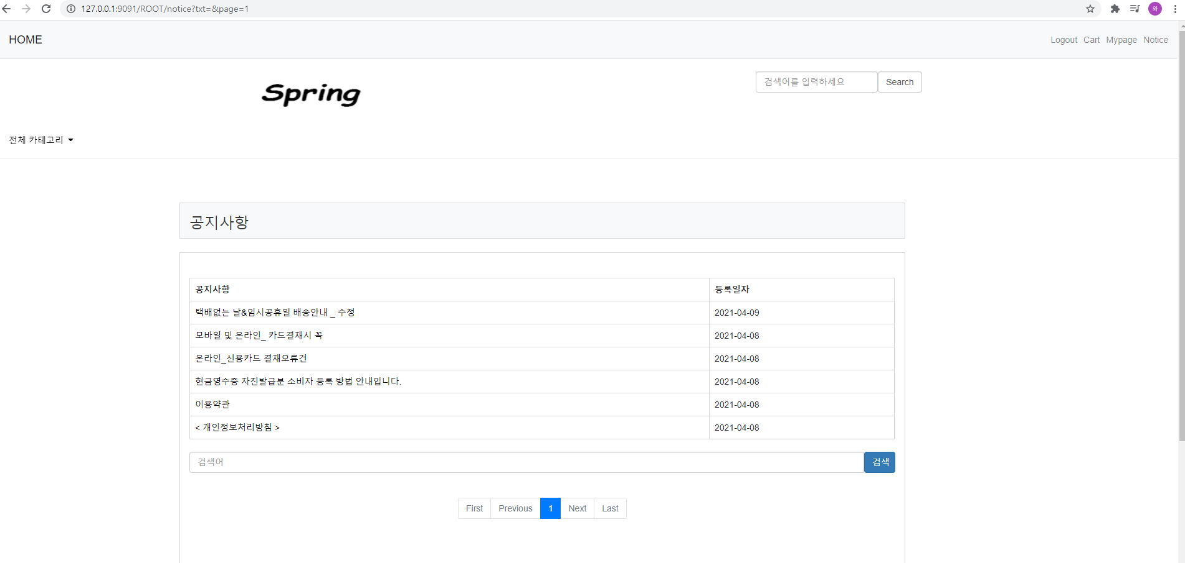
http://127.0.0.1:9091/ROOT/notice?txt=&page=1
▲ ▼

Slide 14
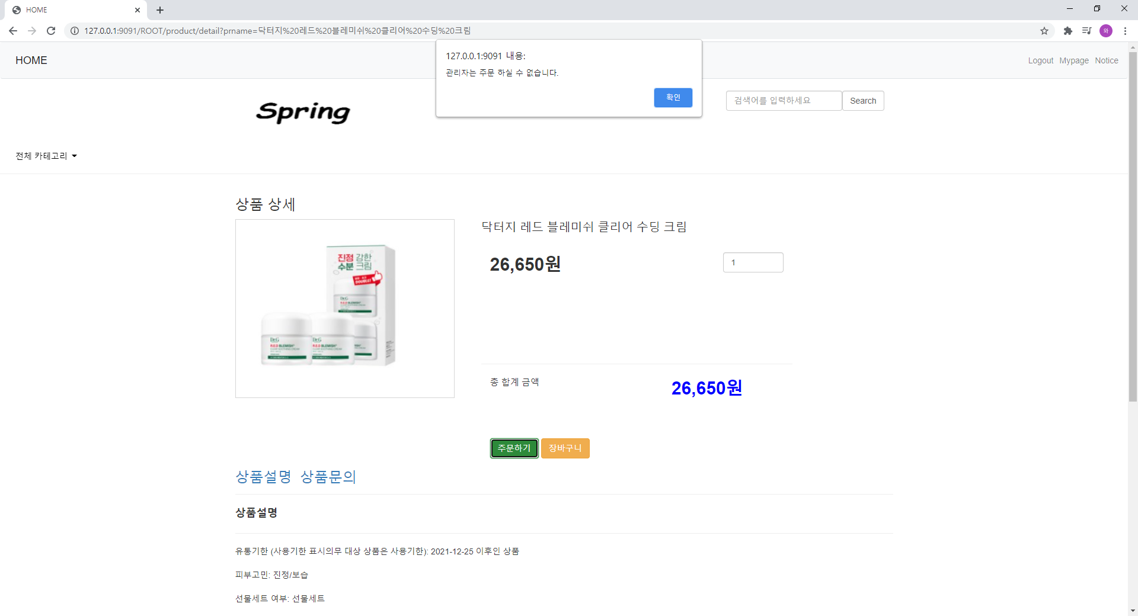
http://127.0.0.1:9091/ROOT/product/select1?id=2
▲ ▼

Slide 15
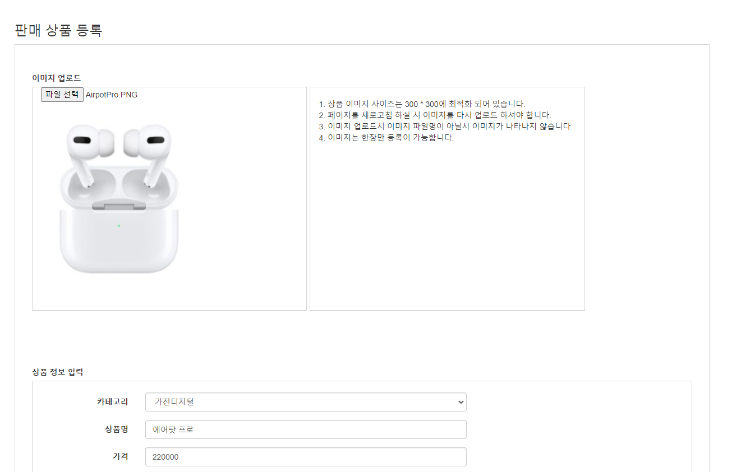
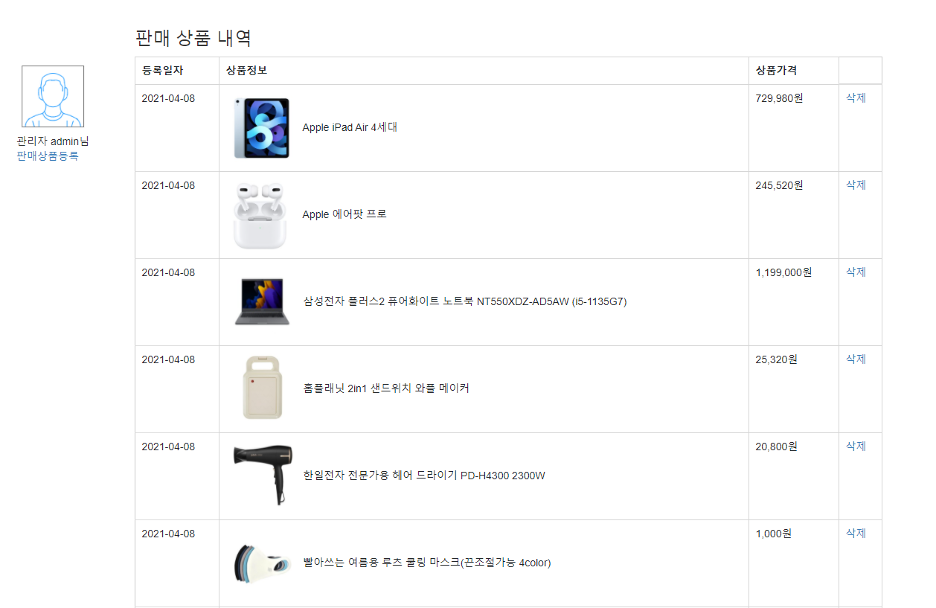
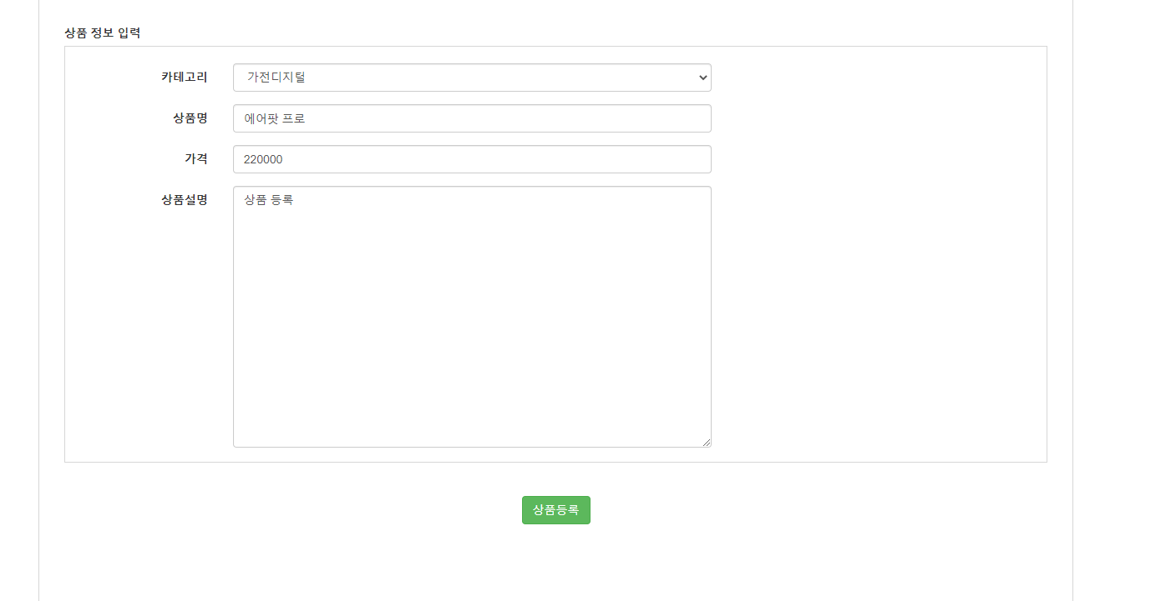
http://127.0.0.1:9091/ROOT/product/select1?id=2
▲ ▼

Slide 16
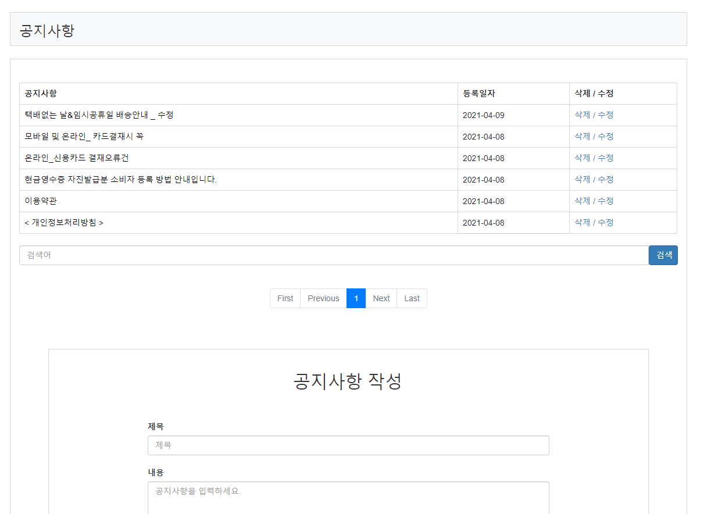
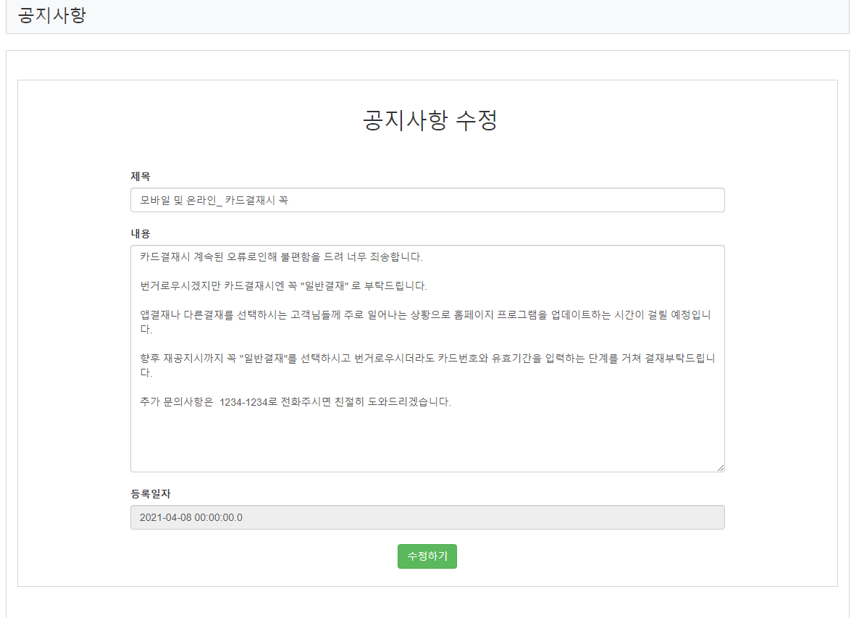
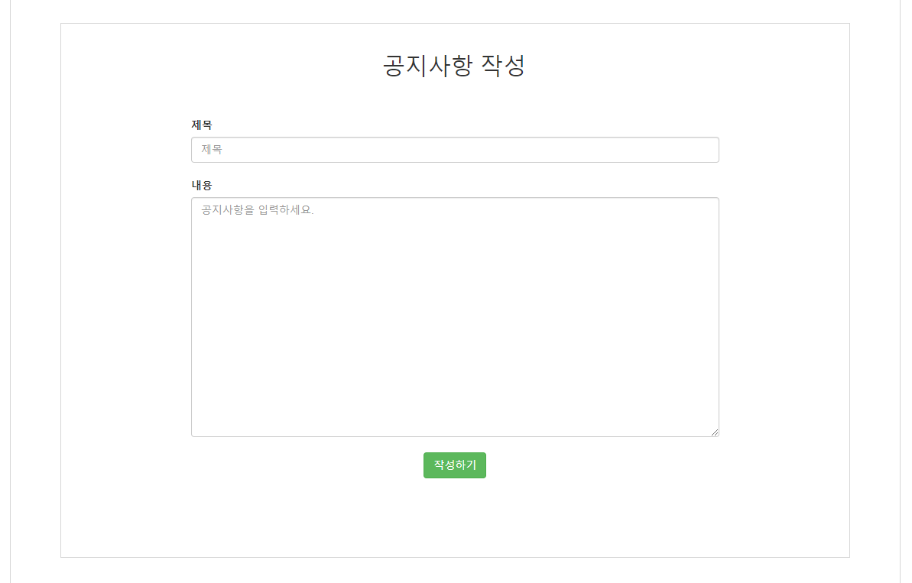
http://127.0.0.1:9091/ROOT/product/select1?id=2
▲ ▼

Slide 17
감사합니다.

